Slide 1
23ECE286 Circuits and Communication Laboratory
Term Project
Date: 04-04-2025
Group ID: 5
Group Members:
ASWIN K(CB.EN.U4ECE23207)
CHITTESH .S(CB.EN.U4ECE23212)
MAMIDI RAHUL(CB.EN.U4ECE23227)

Slide 2
Overview
Introduction
Design
Working Principle
Calculation
Simulation
Results

Slide 3
Project Topic:
1. Design and implement a circuit using op-amp to generate a triangular wave with variable frequency 250 Hz to 2.5 kHz..

Slide 4
Introduction:
A triangular wave generator is a fundamental circuit used in signal processing, waveform synthesis, and function generators. The circuit typically consists of an integrator and a Schmitt trigger.
This involves configuring an operational amplifier (LM741). The Schmitt trigger provides a square wave, which the integrator converts into a triangular waveform. This document presents a triangular wave generator using op-amps with a variable frequency range of 250 Hz to 2.5 kHz.

Slide 5
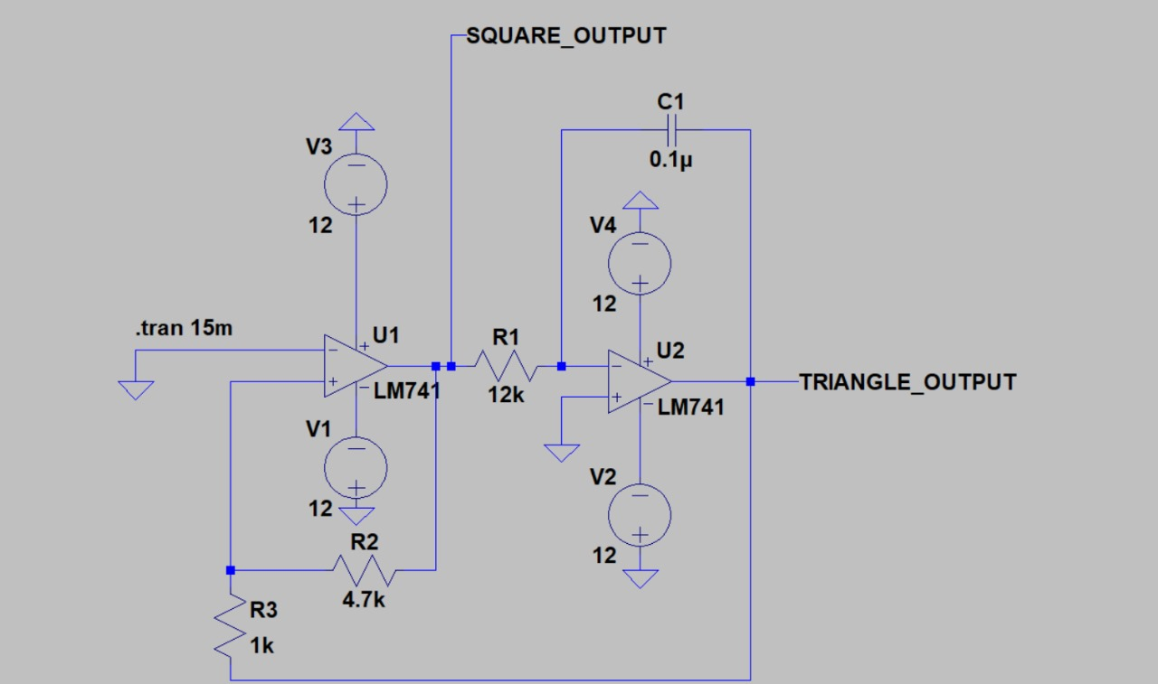
Design:
Schmitt Trigger (Comparator): An op-amp-based comparator generates a square wave by switching between two threshold voltage levels.
Integrator: A second op-amp is used as an integrator with a capacitor and resistor in its feedback loop to convert the square wave into a triangular waveform.
Components requirements:
Two LM741 Op-Amps
Resistors: 12kΩ, 4.7kΩ, 1kΩ
Capacitor: 0.1μF
DC Power Supply: +12V, -12V

Slide 6
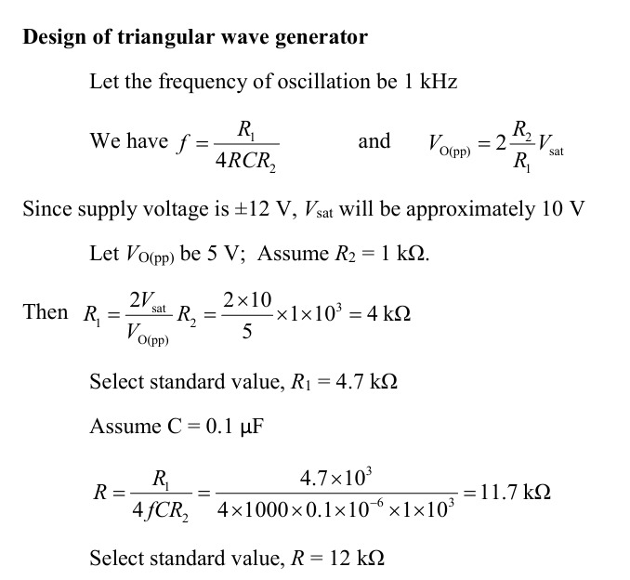

Slide 8
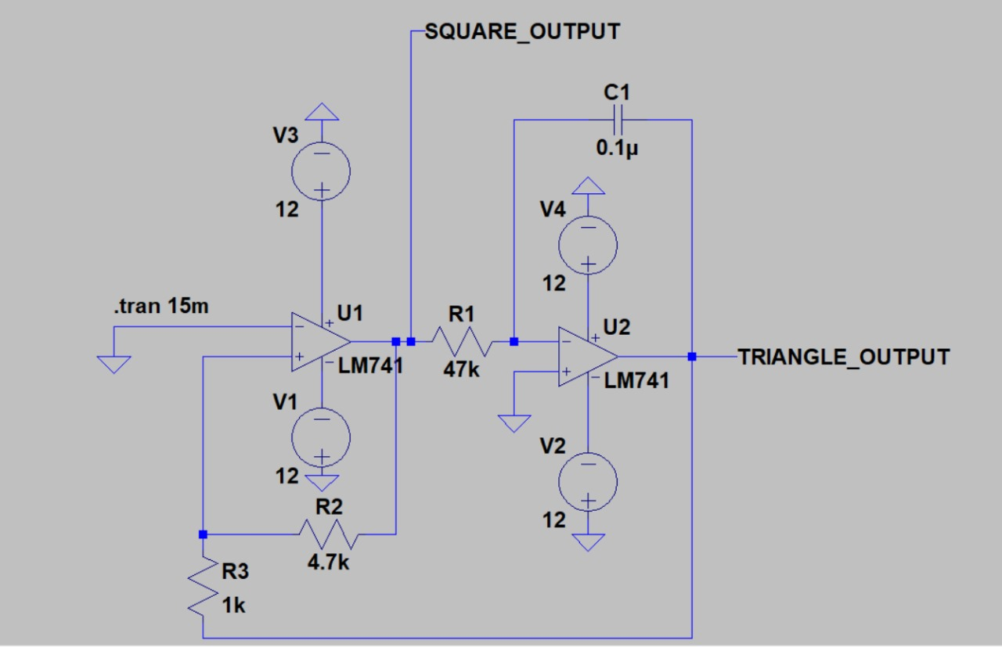
Simulation For Frequency 250 Hz:

Slide 9
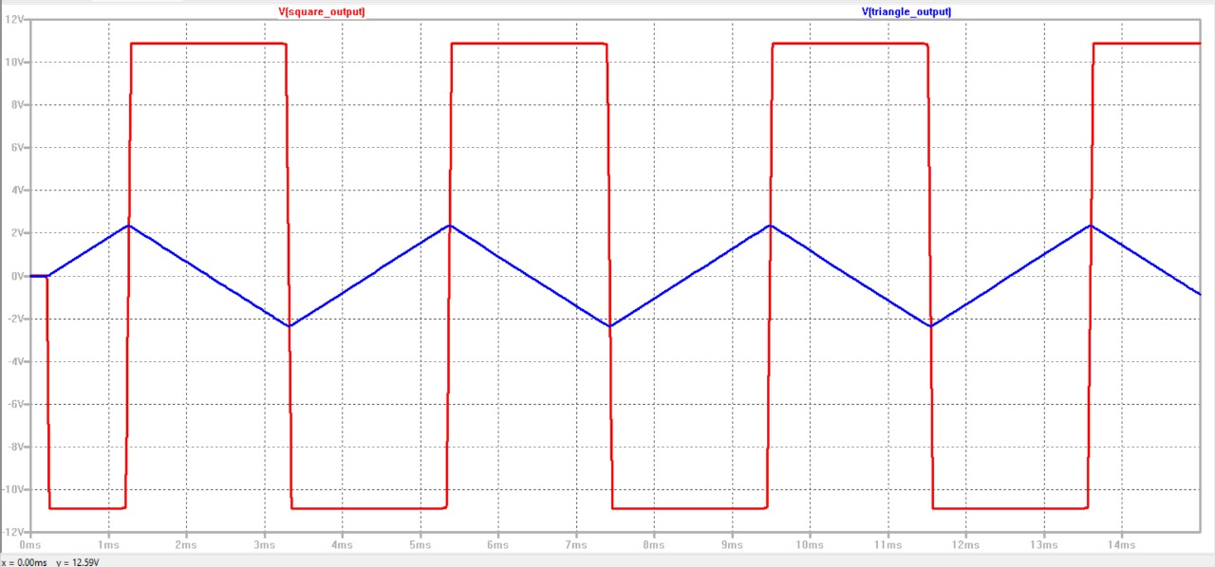
OUTPUT FOR 250 Hz:

Slide 10
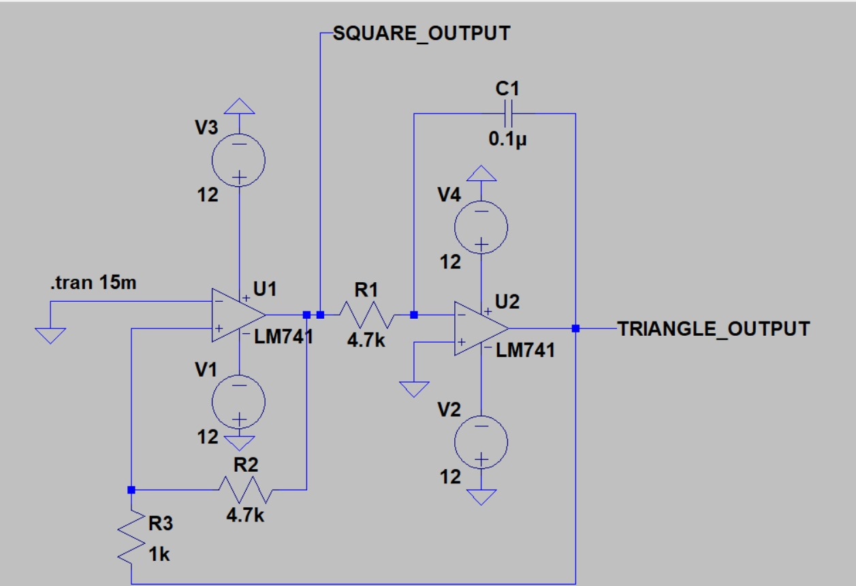
Simulation For 2.5KHz:

Slide 11
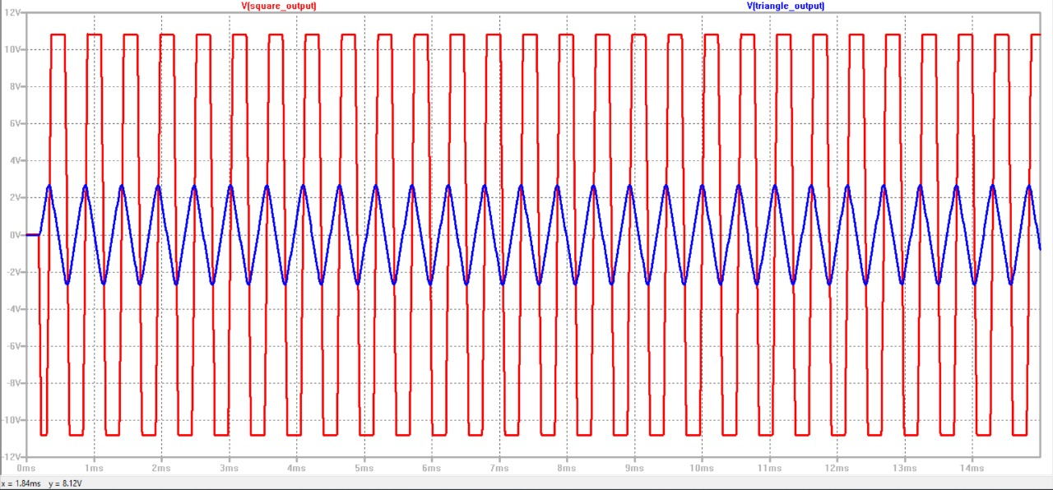
Output for 2.5KHz:

Slide 12
WORKING PRINCIPLE
Working Principle:
Square Wave Generation: The first op-amp (U1) is used as a Schmitt trigger. The inverting terminal is connected to a feedback network, while the non-inverting terminal is set at a reference voltage. When the output crosses a certain threshold, the op-amp switches states, producing a square wave.
Triangular Wave Generation: The square wave is then fed into an integrator (U2), which consists of an op-amp, a capacitor, and a resistor. The integrator converts the input square wave into a triangular waveform as it continuously integrates the square wave signal.
Frequency Control: The frequency can be adjusted by varying the values of resistors or the capacitor in the integrator stage.

Slide 13
Square Wave Output (SQUARE_OUTPUT):
The Schmitt trigger (U1) produces a square wave.
The frequency of the square wave depends on the resistor and capacitor values in the feedback loop.
The amplitude is approximately equal to the op-amp’s supply voltage (+12V and -12V).
Triangular Wave Output (TRIANGLE_OUTPUT):
The integrator (U2) converts the square wave into a triangular wave.
The slope of the triangular wave depends on the RC time constant of the integrator.
The frequency is determined by the Schmitt trigger’s output.
Captured Waveforms from Simulation
Square Wave (SQUARE_OUTPUT): Alternates between +12V and -12V.
Triangular Wave (TRIANGLE_OUTPUT): A continuous linear ramp up and down.

Slide 14
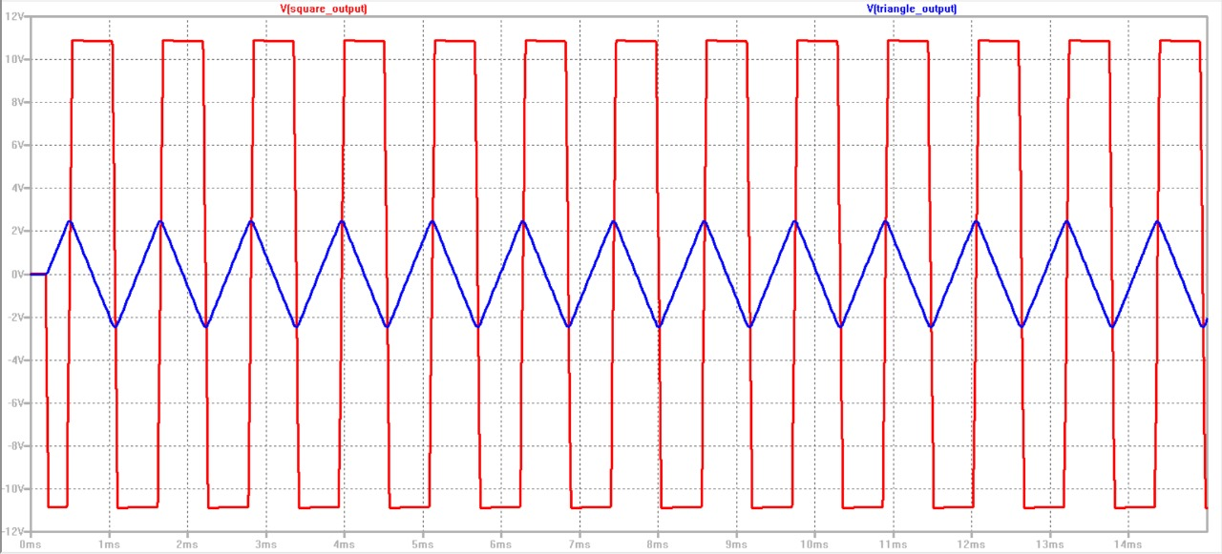
:OUTPI
OUTPUT
Output Signal:

Slide 15
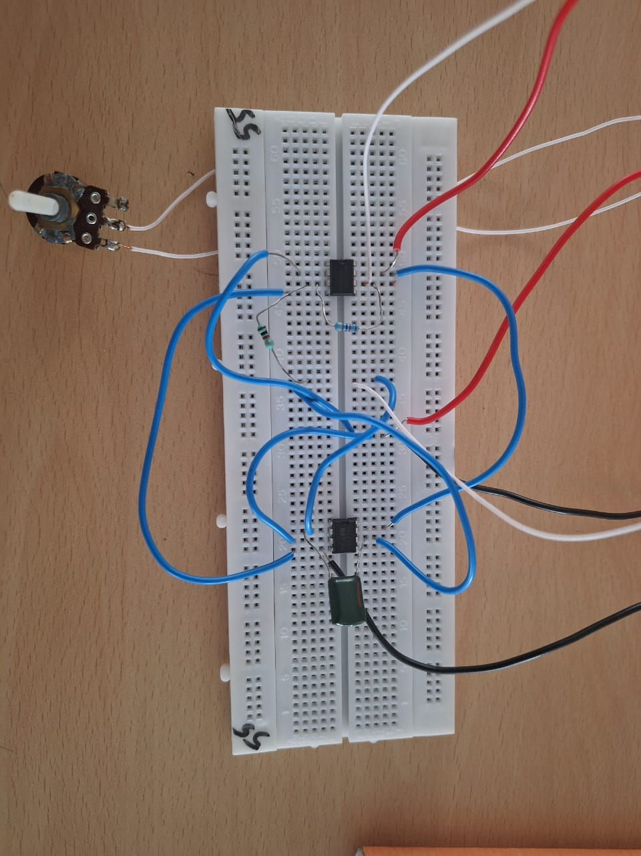
Circuit

Slide 16
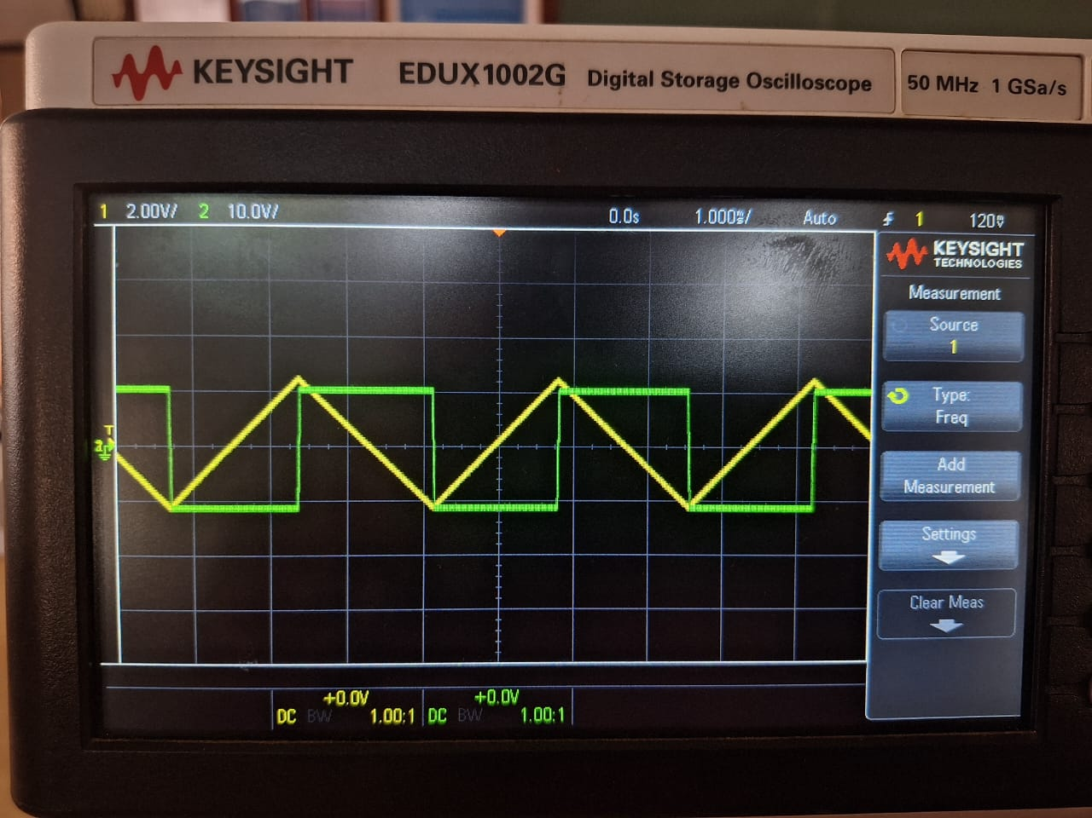
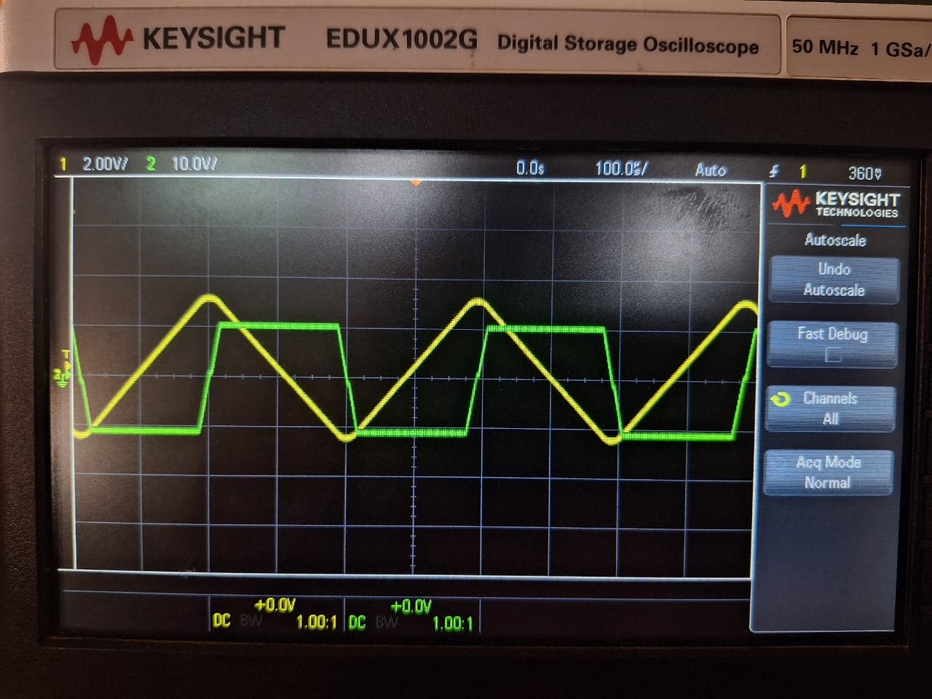
Implemented Results
Potentiometer at 47 KΩ for 250Hz (Implemented)
Potentiometer at 4.7 KΩ for 2.5KHz (Implemented)

Slide 17
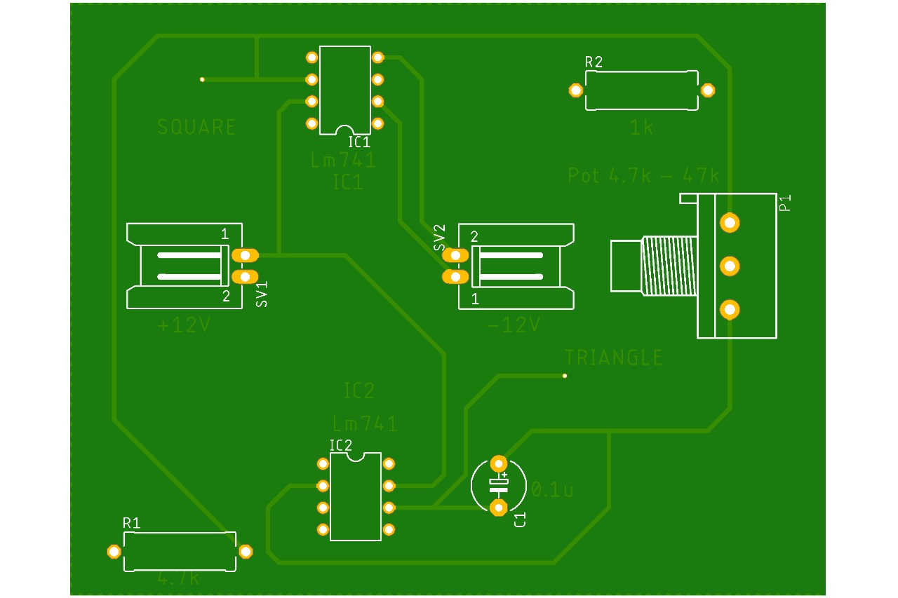
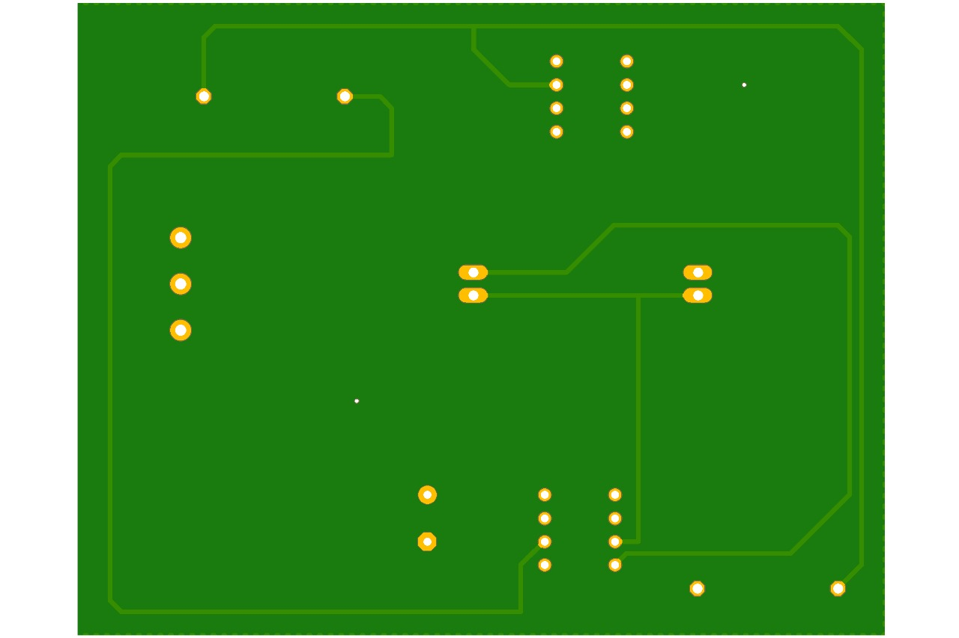
PCB layout
Front
Back

Slide 18
Challenges and Solutions
Challenges Encountered:
Ensuring a stable triangular waveform across 250 Hz to 2.5 kHz was difficult due to component
tolerances and design constraints.
1. Frequency Stability Issues – Resistor and capacitor tolerances caused variations in oscillation
frequency, affecting waveform accuracy.
2. Resistor Value Mismatch – Standard resistor values didn’t match calculated values, slightly
altering the Schmitt Trigger’s threshold.
3. Component Limitations – The LM741 op-amp had bandwidth constraints, causing minor
distortions at higher frequencies.

Slide 19
Challenges and Solutions
Solutions Implemented:
To improve accuracy, we optimized component selection.
1. Precision Components – Used 1% tolerance resistors and adjusted capacitors for stable
performance.
2. Threshold Adjustments – Recalculated Schmitt Trigger thresholds using available resistor
values.
3. Testing & Optimization – Iterative testing with an oscilloscope helped refine resistor values
and improve stability.

Slide 20
RESULTS:
Results:
The circuit successfully generates a triangular wave from a square wave input.
The frequency of the triangular wave is adjustable within the desired range.
The simulation results confirm the theoretical calculations.
The output waveforms match expected characteristics.
Conclusion :This project demonstrates the design and implementation of a triangular wave generator using op-amps. The use of a Schmitt trigger and an integrator enables the generation of stable and adjustable waveforms. The circuit finds applications in function generators, signal processing, and waveform synthesis.

Slide 21
Thank you

